Slide 1
Data Analysis using Python
P0 Project
Done By:
R.Likitha

Slide 2
Introduction
Data analysis is a crucial aspect of understanding and deriving insights from data in various domains, including weather forecasting, finance, healthcare, and more.
Python, with its extensive libraries and ease of use, is a popular choice for data analysis projects.
In this project, we will explore data analysis using a Diwali dataset, which contains various meteorological variables.

Slide 3
Objective
The primary objective of this project is to perform a comprehensive analysis of the weather data to uncover patterns, trends, and insights.
Specifically, we aim to:Understand the Dataset: Gain familiarity with the structure and contents of the Weather.csv file.
Data Cleaning and Preprocessing: Handle missing values, remove duplicates, and preprocess data for analysis.
Exploratory Data Analysis (EDA): Visualize and summarize the data to identify trends and correlations.

Slide 4
Tools and Techniques
We will use Python as the primary programming language for data analysis, leveraging libraries such as:
Pandas: For data manipulation and analysis.
NumPy: For numerical operations.
Matplotlib: For data visualization.
Seaborn: For enhanced data visualization and statistical plotting.

Slide 5
Dataset Description
The dataset, diwali_sales.csv, contains detailed information about transactions
made during the Diwali festival. It includes the following features:
User_ID
Cust_name
Product_ID
Gender
Age Group
Age
Marital-status
State
Zone
Occupation
Product_Category
Orders
Amount

Slide 6
Methodology
Data Preprocessing: Cleaning the dataset to handle missing values, inconsistencies, and outliers.
Steps in Data Preprocessing
1. Loading the Data
The first step is to load the dataset into a Python environment. We use the Pandas library for this purpose:
2. Data Cleaning
Data cleaning involves handling missing values, correcting errors, and removing duplicates.
a. Handling Missing Values
Check for missing values and decide how to handle them. Common strategies include filling missing values with mean, median, or mode, or dropping rows with missing values.
b. Removing Duplicates
Remove any duplicate entries that might skew the analysis.

Slide 7
3. Data Transformation
Data transformation includes converting data types, creating new features, and standardizing or normalizing data.
a. Converting Data Types
Ensure that all columns have appropriate data types.
b. Feature Engineering
Create new features that might be useful for analysis. For example, extracting the month from the purchase date:
4. Data Exploration
Perform initial exploration to understand the data distribution and identify any outliers or anomalies.
5. Handling Categorical Data
Convert categorical variables into numerical format using techniques such as one-hot encoding.

Slide 8
Exploratory Data Analysis (EDA)
Objectives
Understand the structure and distribution of the data.
Identify patterns, trends, and correlations in the data.
Gain insights into consumer behavior during the Diwali festival.
Highlight any anomalies or outliers that may need further investigation.
Steps in EDA:
1. Understanding the Data Structure
Start by examining the basic structure and summary statistics of the dataset.
2. Analyzing Categorical Variables
Explore categorical variables to understand the distribution and frequency of different categories.

Slide 9
3. Analyzing Numerical Variables
Examine the distribution of numerical variables and identify any outliers or skewness.
4. Analyzing Relationships between Variables
Investigate relationships between different variables to uncover patterns or correlations.
a. Correlation Matrix
Examine the correlation between numerical variables.
b. Bar Plot
Visualize the relationship between categorical data.
5. Time Series Analysis
Analyze the sales trends over time, particularly focusing on sales during the Diwali period.
6. Analyzing Demographic Factors
Examine how demographic factors such as age and gender influence purchasing behavior.

Slide 10
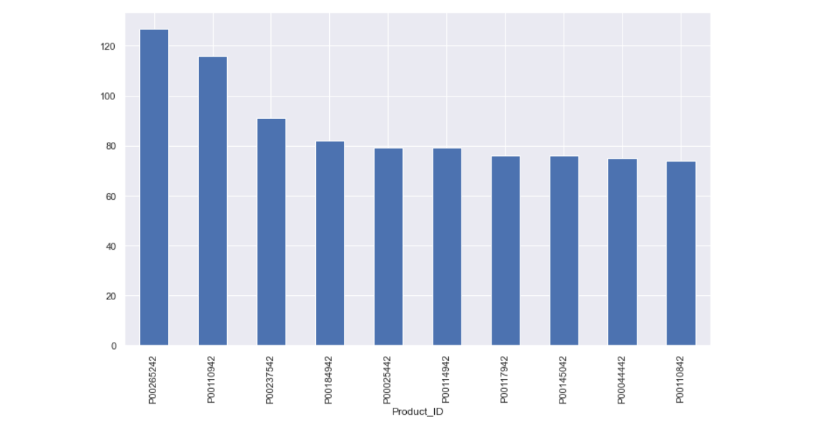
Output
CONCLUSION
I hereby conclude that I have solved all the queries and analyzed it very well in the way it gave me the accurate results.

Slide 11
Thank you

